Slide 1
How do basic surgical techniques using the DaVinci machine vary with robotic surgical experience and technical skills scores?
Viha Chakrapani, Margaret Li, Ramya Palani

Slide 2
Context
The DaVinci surgical system is a robotic surgical system that
uses minimally invasive techniques
gives surgeons magnified, 3D high-definition views
Allows for much greater range of motion than the human hand
Commonly used for many procedures including prostate, kidney, and gynecological operations
Notes:
ramya

Slide 3
Risk Factors
If surgeons do not learn to adapt techniques or learn new techniques, the DaVinci machine is futile.
If there are issues or complications, the surgeons will have to revert to open surgery with larger incisions.
Notes:
ramya

Slide 4
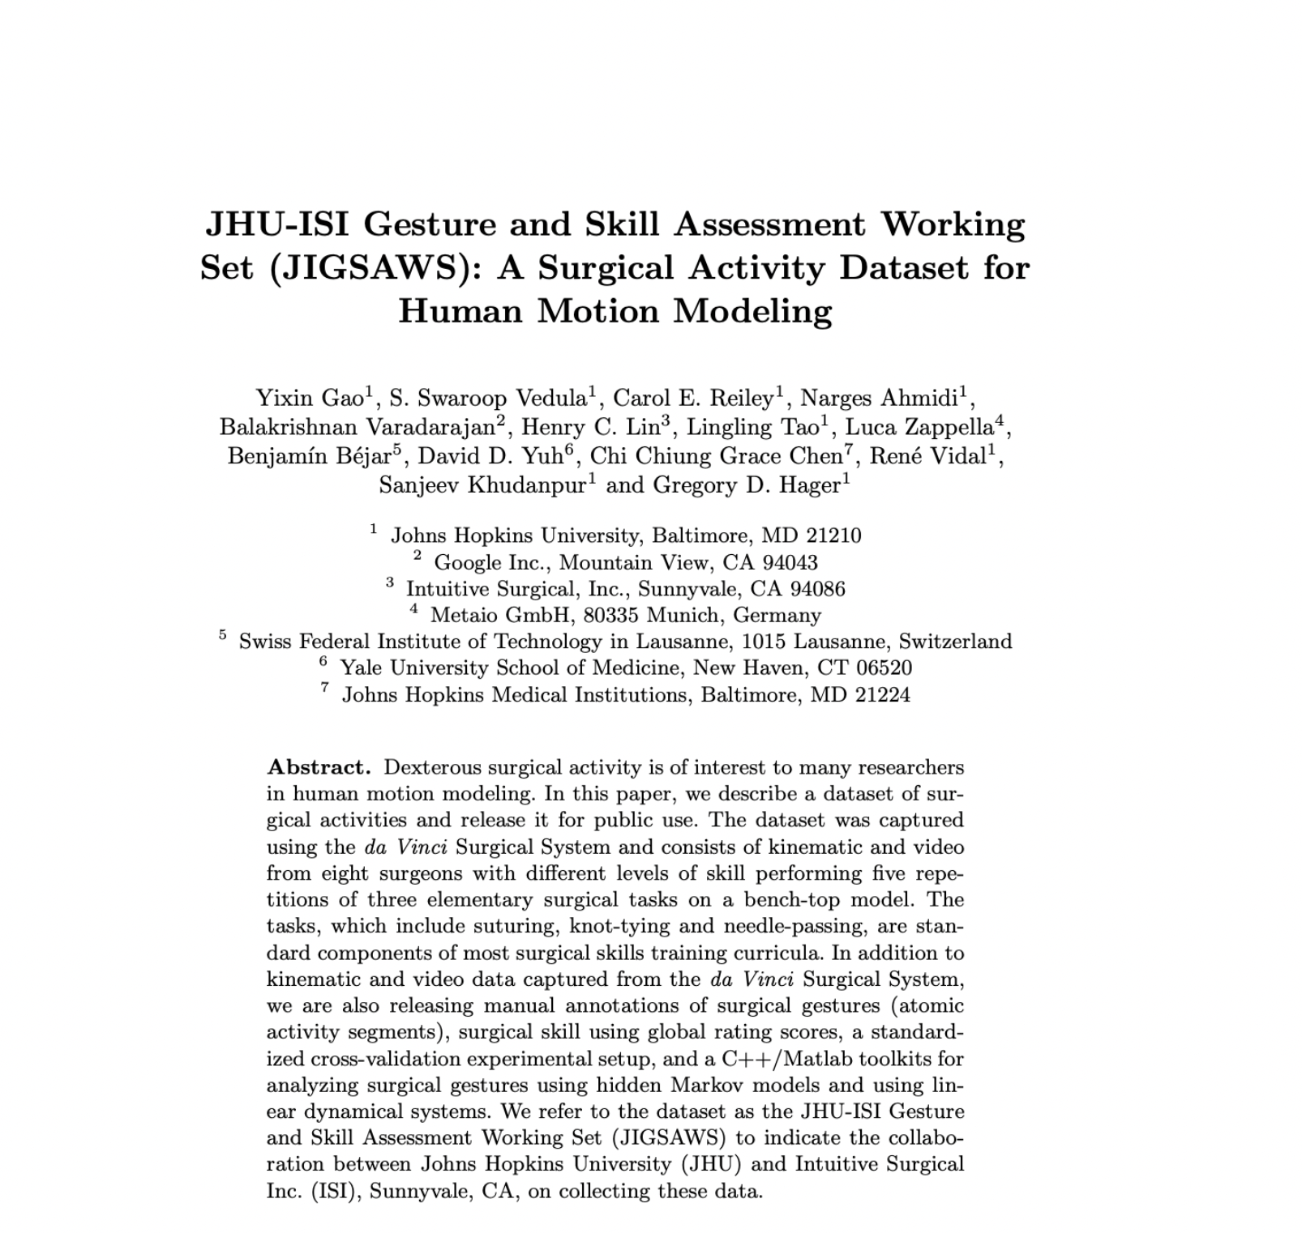
What data did we look at?
We analyzed the relationship between surgeons’ experience level with robotic surgery (Novice = < 10 hrs, Intermediate = 10-100 hrs , Expert = 100+ hrs ) and their corresponding OSATs (Objective Structured Assessment of Technical Skills) scores (from lowest (1) to highest (5)) for the following skills:
Knot Tying
Needle-Passing
Suturing
Notes:
ramya

Slide 5
Challenges we Faced
Difficulty obtaining datasets
Many of the sets we wanted to use that looked at current trends and hospitals adopting robotic surgery were conducted after getting IRB approval
Difficulty accessing large quantities of data
Difficulty cleaning/sorting data
Notes:
viha

Slide 6
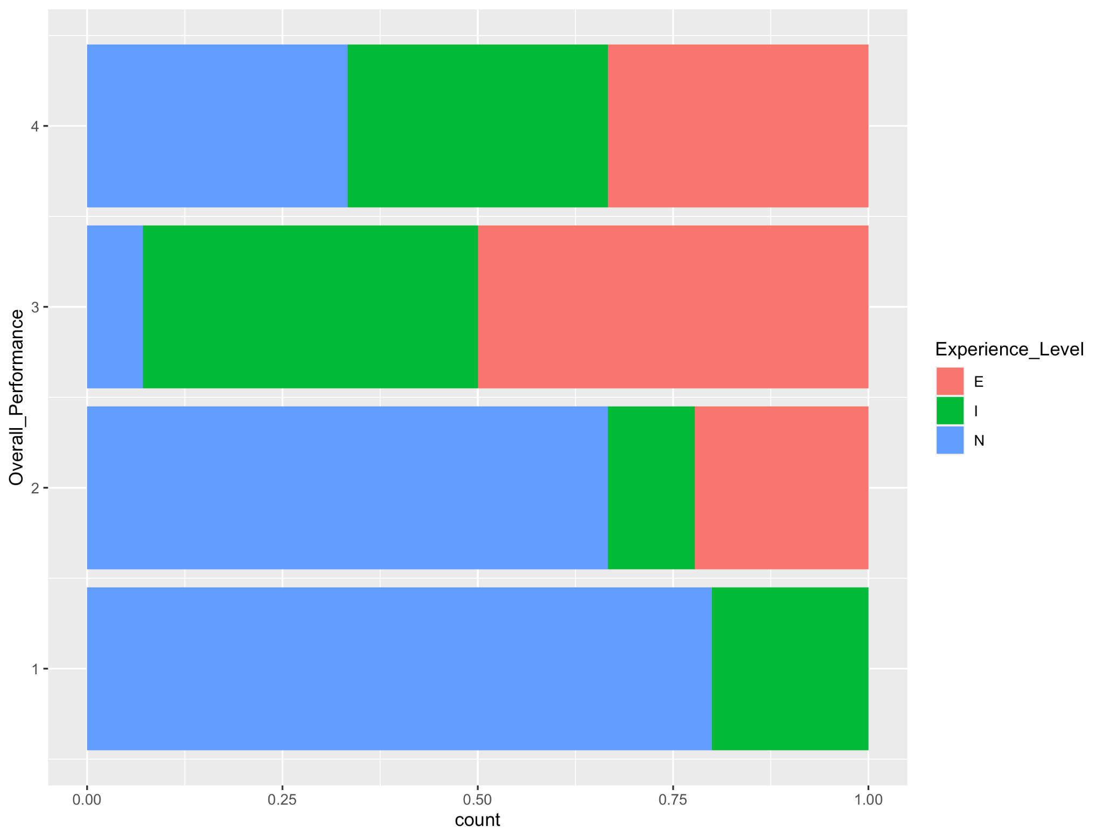
Knot-Tying
Gestalt Principles:
Continuity: there are no breaks in the coloring
Similarity: grouping same colors together
There is no strong correlation between overall performance and experience level - however those with novice experience levels tended to have lower performance scores and those with expert experience levels tended to have higher performance scores.
Notes:
viha

Slide 7
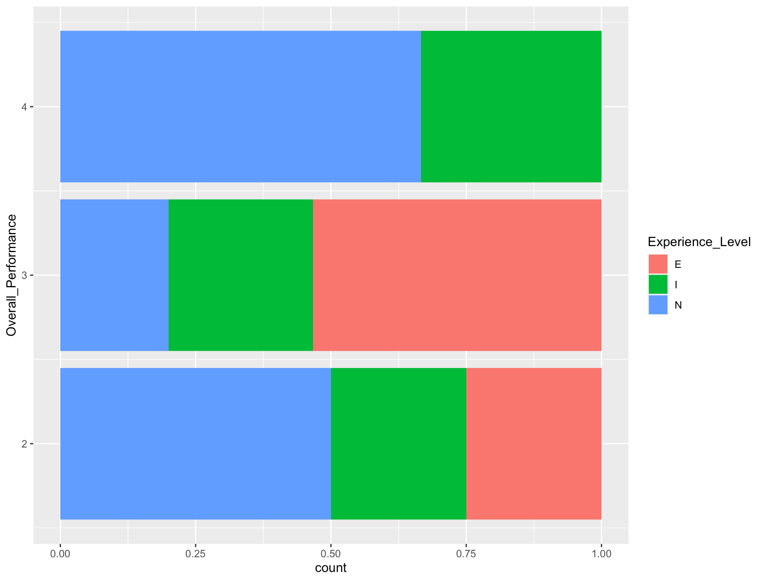
Needle-Passing
The plot shows that there is no strong correlation between overall performance and experience level in regard to needle-passing.
Additionally, a larger proportion of novices received high score of 4 compared to experts and intermediates. No expert experiences level surgeons received a 4 and no surgeons received the highest score of 5.
Notes:
viha

Slide 8
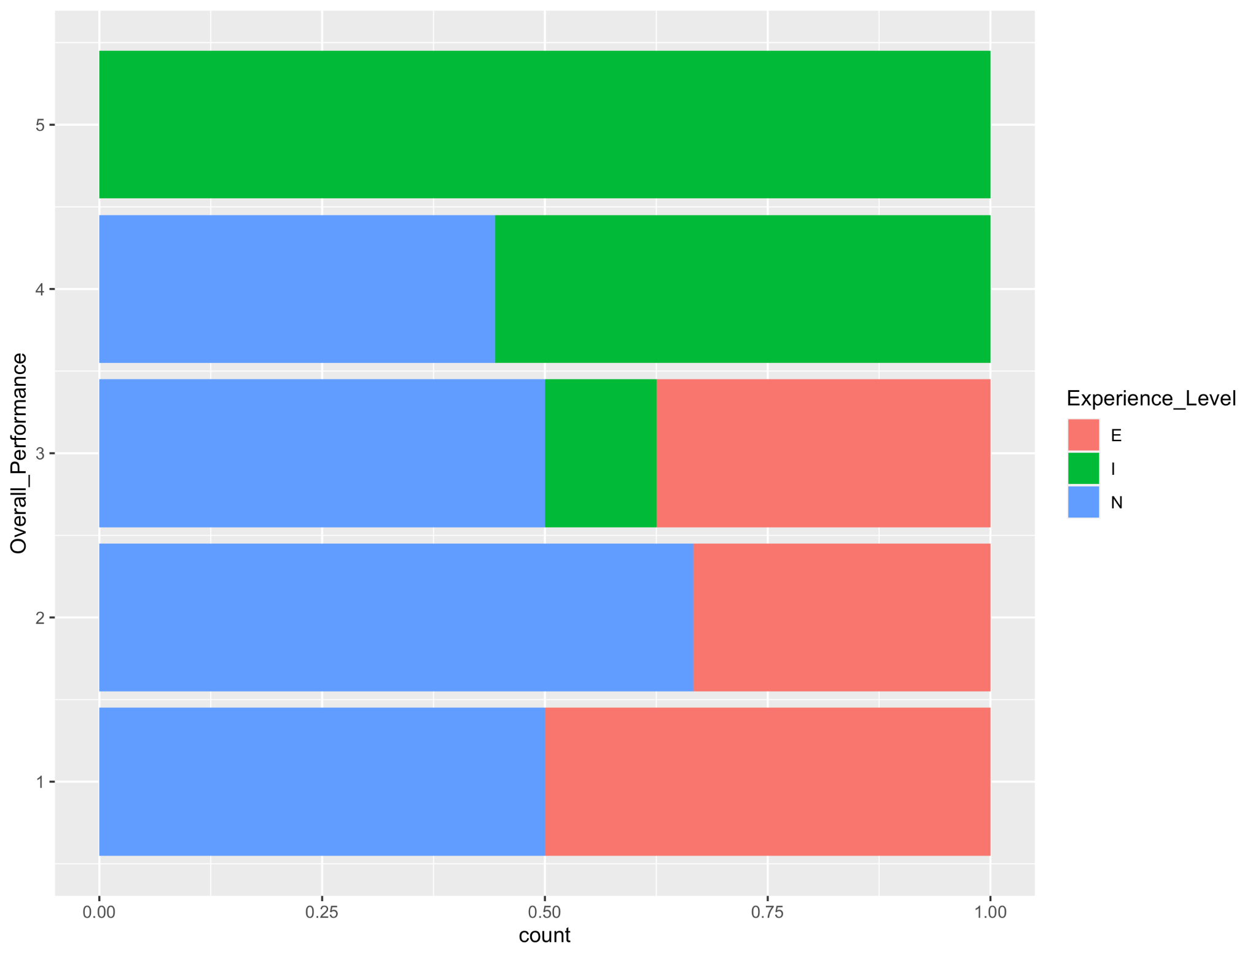
Suturing
Interestingly, only those with intermediate experience levels scored a 5 in suturing, and none scored below a 3
Experienced surgeons scored the lowest overall among all levels
A possible explanation could be that suturing is the easiest of the 3 technical tasks to do with the robot → does not need a lot of robotic experience to accomplish it well

Slide 9
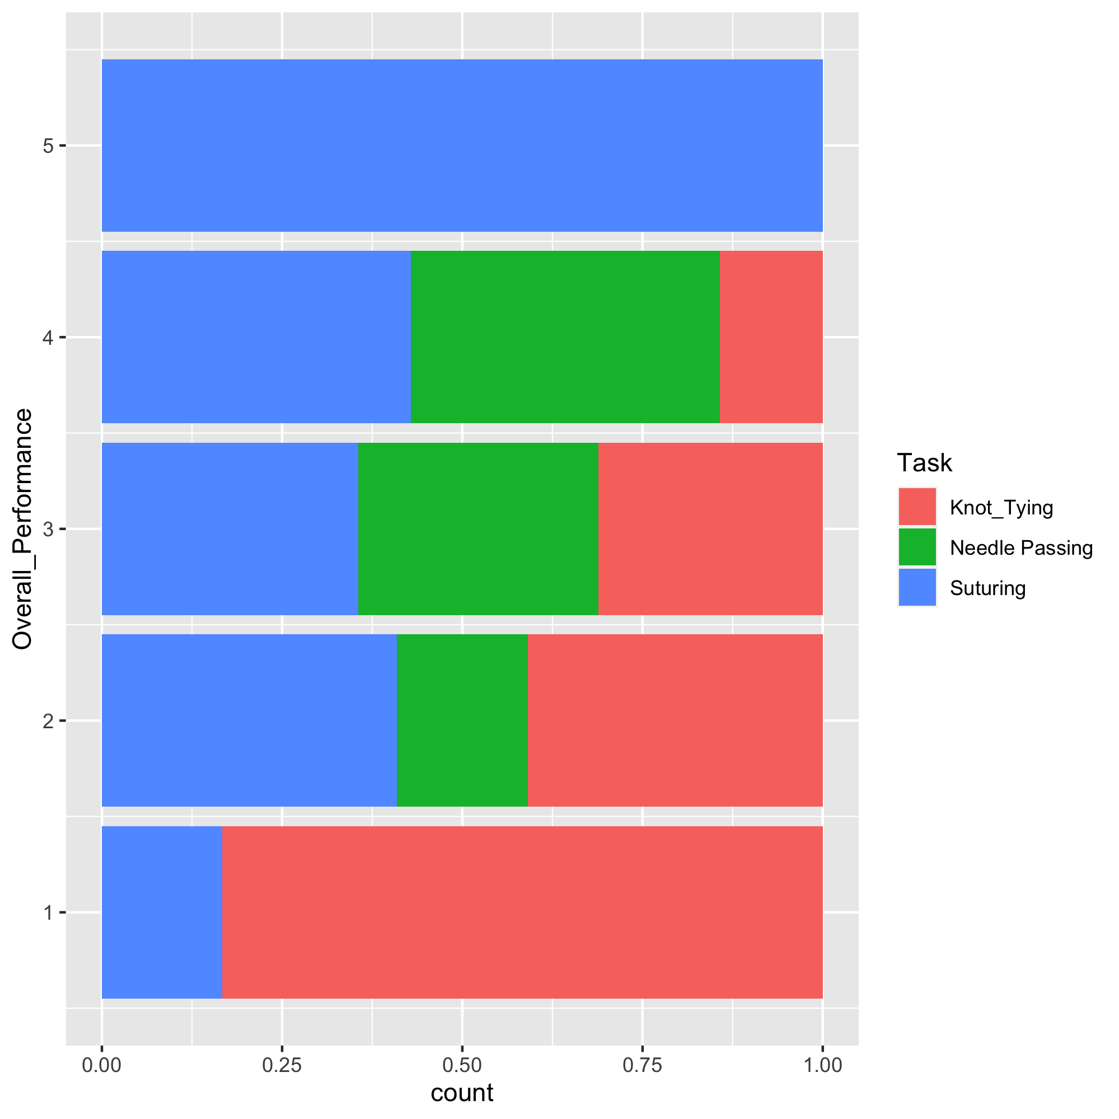
Comparing Overall Performance across Tasks
Observations:
Knot Tying across all experience levels generally received the lowest scoring
Suturing received generally higher scores
Can be attributed to task difficulty
Gestalt Principles:
Similarity: group similar colors together
Continuity: there are no breaks in the colors or empty spaces

Slide 10
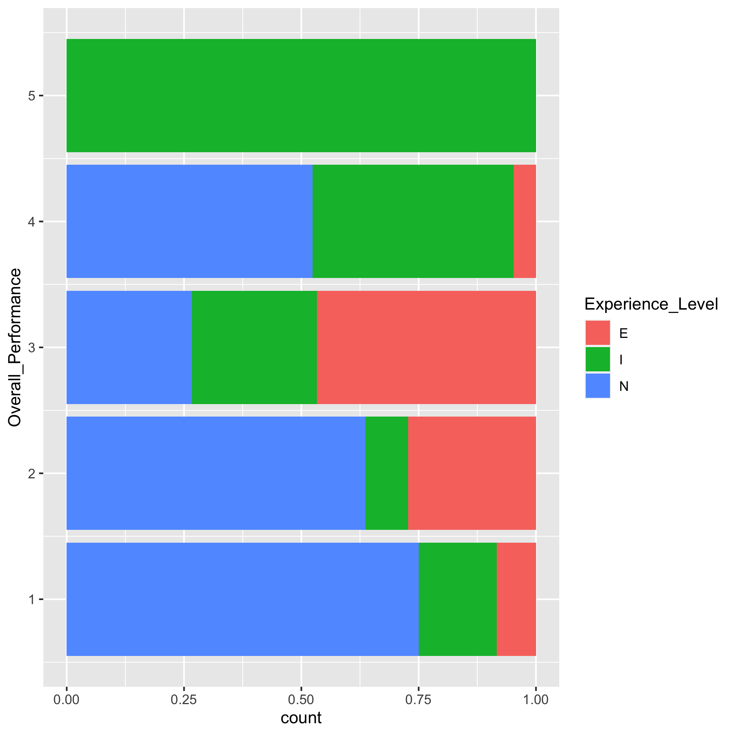
Comparing Overall Performance against Experience Levels
Observations
Interestingly, only surgeons that were at intermediate experience levels received the highest score of 5
A small percentage of surgeons with expert experience levels received the lowest score of 1

